Slide 1
Arctic Sea-Ice and Climate Change

Slide 2
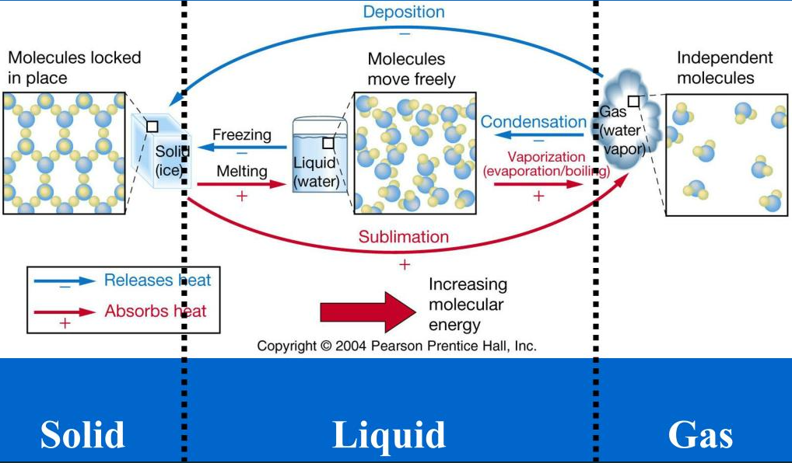
Water is the only substance that exists in three states.
From PPT - Physical Properties of Seawater PowerPoint Presentation, free download - ID:1824136 (slideserve.com)
Notes:
Water is the only substance that naturally occurs as solid, liquid and gas state on Earth. The three-state changes of water makes hydrologic cycle between different water bodies and different Spaces, which promotes material migration and energy conversion on the Earth, and has a profound impact on the natural environment.

Slide 3
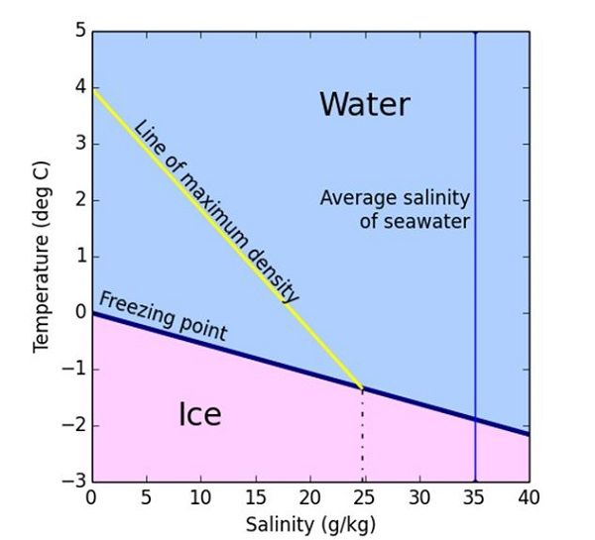
Formation of ice from seawater
When salinity < 25, similar to freshwater.
When salinity >25, The ice formation process is complicated
thermocline
Figure 1: Freezing temperature (blue line) versus temperature of maximum density (yellow line) for saline water.
Notes:
The salt forces the freezing point of seawater to be lower (see the blue line in the figure). Typically seawater with a salinity, or salt content, of 35 parts per thousand (or 3.5%) will have a freezing point of around -1.8 degrees celsius. The point of maximum density for seawater also decreases with increasing salinity but at a faster rate than the freezing temperature does; this is shown by the yellow line in Figure 1. For salt water with salinity above 25 parts per thousand the temperature of maximum density is below the freezing temperature. The majority of seawater has salinity above 25 which means that sea water cooled from above continues to cause convection right down to the freezing point. This means that sea ice does not form in a uniform way like freshwater ice and is much more complicated.

Slide 4
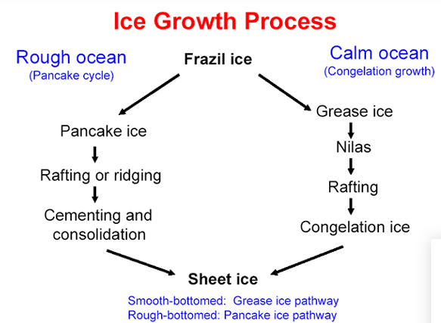
Sea-ice Growth Process
Sea ice is frozen seawater which floats on the surface of the ocean.
Notes:
Sea ice is frozen seawater which floats on the surface of the ocean.
When the ocean starts to freeze, ice initially takes the form of lots of little crystal discs called 'frazil', which float independently on the sea surface.

Slide 5
Notes:
Sea ice that is not more than one winter old is known as first-year ice. Sea ice that survives one or more summers is known as multiyear ice. Most Antarctic sea ice is first-year pack ice. Multiyear ice is common in the Arctic, where most of it occurs as pack ice in the Arctic Ocean.

Slide 6
Distribution of Sea Ice
Distribution: high latitude regions where there is little or no sunlight in the winter and so atmospheric conditions are cold enough for the ocean to freeze. (sea ice, frozen seawater in the Arctic Ocean and its adjacent seas as far south as China and Japan and in the Southern Ocean and its adjacent seas surrounding Antarctica.)
Arctic: Northern Hemisphere sea ice extent typically ranges from approximately 8 million square km in September to approximately 15 million square km in March.
Antarctic : Southern Hemisphere sea ice extent ranges from approximately 4 million square km in February to approximately 20 million square km in September.

Slide 7
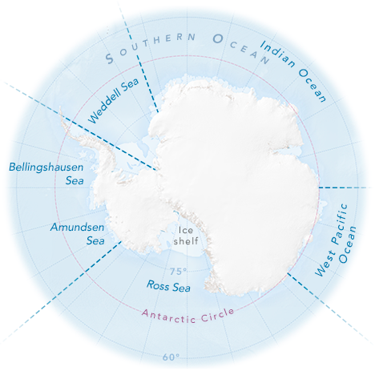
Antarctic Sea Ice
Antarctic : Southern Hemisphere sea ice extent ranges from approximately 4 million square km in February to approximately 20 million square km in September.
In the Southern Ocean, sea ice fringes the entire Antarctic continent. Researchers typically subdivide Antarctic sea ice into five sectors, each influenced by different geography and weather conditions. (NASA Earth Observatory map by Joshua Stevens, based on data from the Norwegian Polar Institute and Natural Earth.)
Notes:
Unlike the Arctic—an ocean basin surrounded by land—the Antarctic is a large continent surrounded by an ocean. Because of this geography, sea ice has more room to expand in the winter. But that ice also stretches into warmer latitudes, leading to more melting in summer. Antarctic sea ice peaks in September (the end of Southern Hemisphere winter) and usually retreats to a minimum in February.

Slide 8
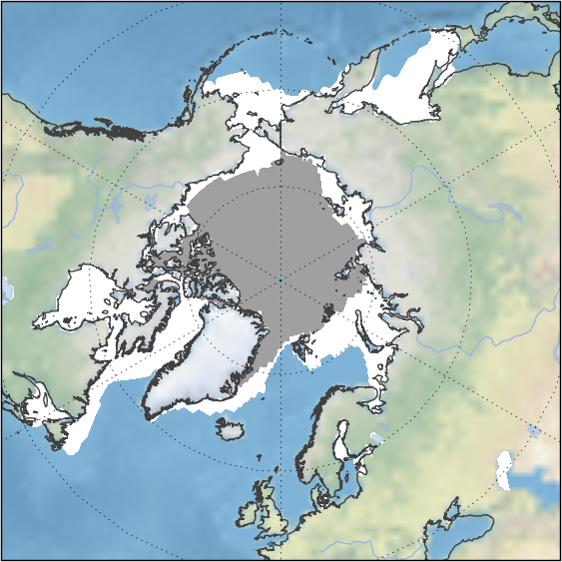
Arctic Sea Ice
Arctic: Arctic sea ice reaches a maximum extent of about 15-16 million square km in February or March and a minimum extent of about 5-6 million square km in September.
Figure 3: Average Arctic sea ice summer minimum (grey) and winter maximum (white) over the period 1981-2010. Data are from Met Office Hadley Centre HadISST dataset.
Notes:
Multiyear sea ice, as mentioned above, is common in the Arctic regions , where most of it occurs as pack ice in the Arctic Ocean. Arctic sea ice reaches a maximum extent of about 15-16 million square km in February or March and a minimum extent of about 5-6 million square km in September. Scientists are more interested in studing Arctic sea ice.

Slide 9
Greenhouse Effect
Schematic diagram of the basic principles of global climate change
Solar Short-wave Radiation
H₂O、CO₂、CH₄……
Greenhouse effect
Earth and atmospheric long-wave radiation
Notes:
The greenhouse gases, such as carbon dioxide, methane, nitrous oxides, and water vapor, can absorb the long-wave radiation, emitted by Earth. These heat-trapping gases can be thought of as a blanket wrapped around Earth, keeping the planet warmer than it would be without them.

Slide 10
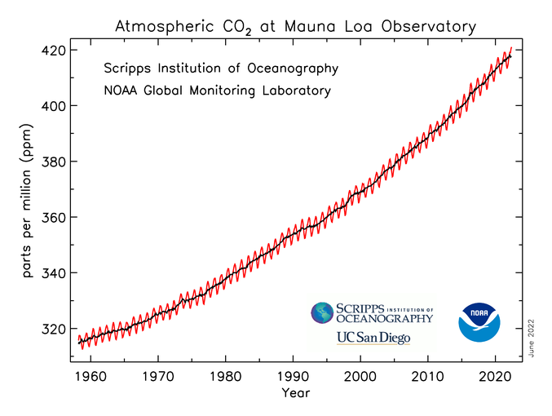
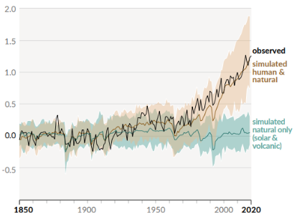
Global Climate Change
IPCC:The Intergovernmental Panel on Climate Change
IPCC, AR6, 2021
Atmospheric CO2 at Mauna Loa Observatory
Observations and model simulations of atmospheric temperature
Notes:
Since the Industrial Revolution, humans have burned a lot of fossil fuels, causing global CO2 increase and global warming.
The Intergovernmental Panel on Climate Change (IPCC) is the United Nations body for assessing the science related to climate change. IPCC reports have indicated that Since the Industrial Revolution, global temperatures have increased by more than 1 degree. The warming is mainly due to anthropogenic activities, namely, the discharge of greenhouse gases and land use change.

Slide 11
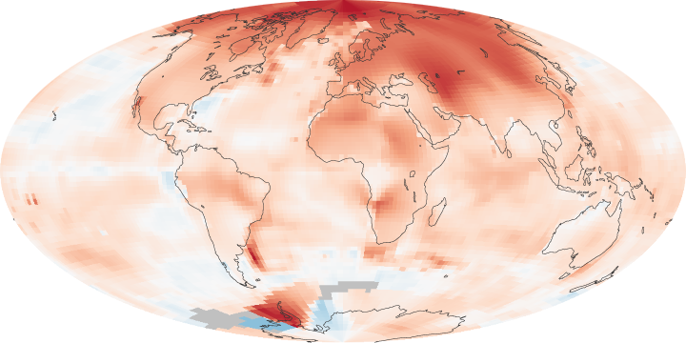
Arctic amplification
Temperatures have increased about twice as fast in the Arctic as in the mid-latitudes, a phenomenon known as “Arctic amplification.”.
January 1, 2000 - December 31, 2009
Arctic Amplification (nasa.gov)
Notes:
The polar regions are sensitive to climate change. Temperatures of arctic regions are rising at twice of the global rate, sparking an array of changes unlike anything in recorded history. Temperatures have increased about twice as fast in the Arctic as in the mid-latitudes, a phenomenon known as “Arctic amplification.” One of the most striking examples is the region's sea ice, whose dramatic decline over the past decade has led to forecasts of an ice-free Arctic Ocean as early as the 2030s.

Slide 12
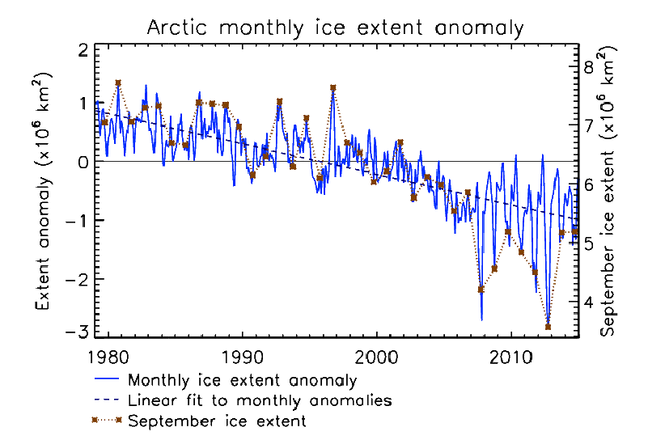
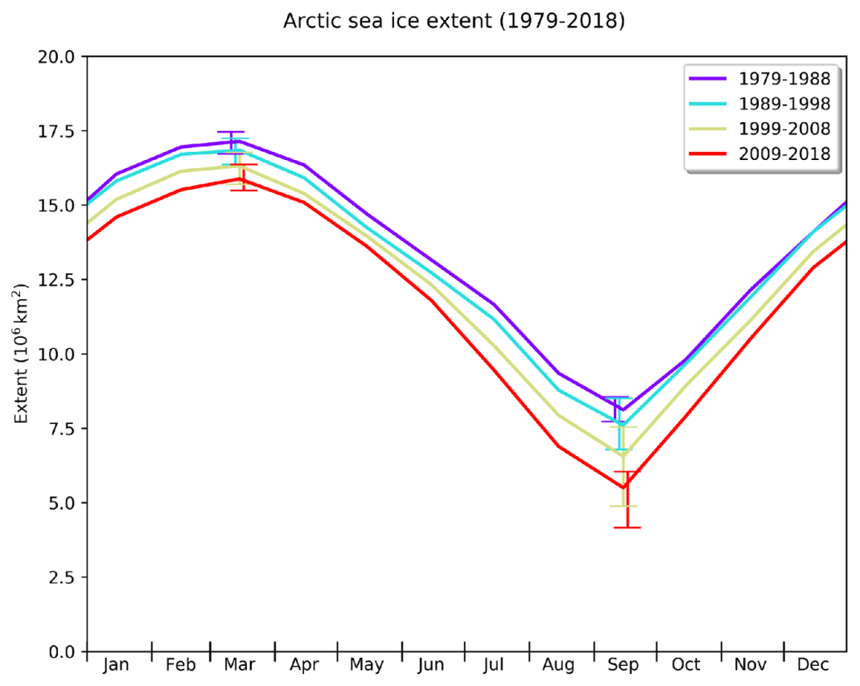
Arctic sea ice extent decline
Changes to the seasonal cycle of Arctic sea ice cover
Figure 2: Arctic sea ice extent decline: observations of monthly extent anomaly (difference from the 1981-2010 average) in blue (left axis). Actual sea ice extent for September is also shown in red (right axis).
The extent of the sea ice is defined by areas that have an ice concentration of at least 15%, i.e. 15% of the surface is covered by ice.
Notes:
The extent of the sea ice is defined by areas that have an ice concentration of at least 15%.
Summer Arctic sea ice extent is shrinking by 50%.and is now shrinking at a rate of 13% per decade, compared to its average extent during the period of 1981 to 2010.
Figure 4 shows the seasonal cycle for various periods derived from satellite measurements. Notably not all of the Arctic sea ice is melted each year and much of it persists through the summer to form 'multi-year' ice. Multi-year ice tends to be thicker than new first year ice and, owing to brine rejection, has a higher mechanical strength.

Slide 13
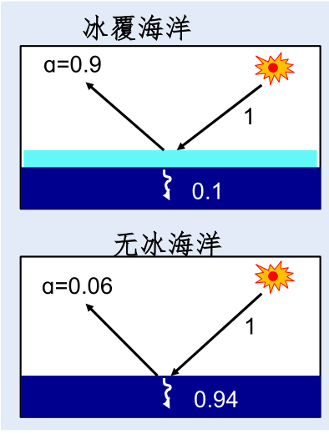
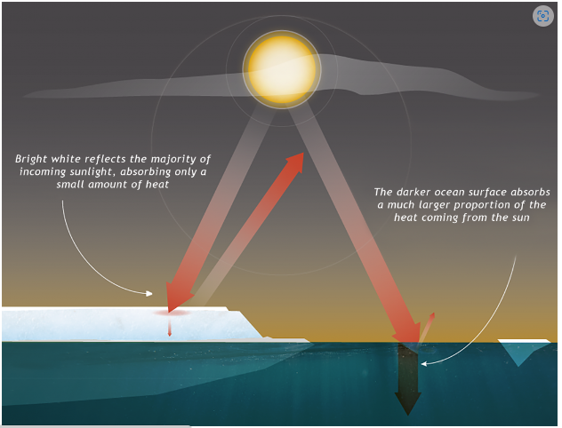
Ice with snow
Open Sea
Notes:
As sea ice is more reflective than the surrounding ocean, the existence of multi-year ice through the summer months is an important regulator of climate conditions in the Arctic.

Slide 14
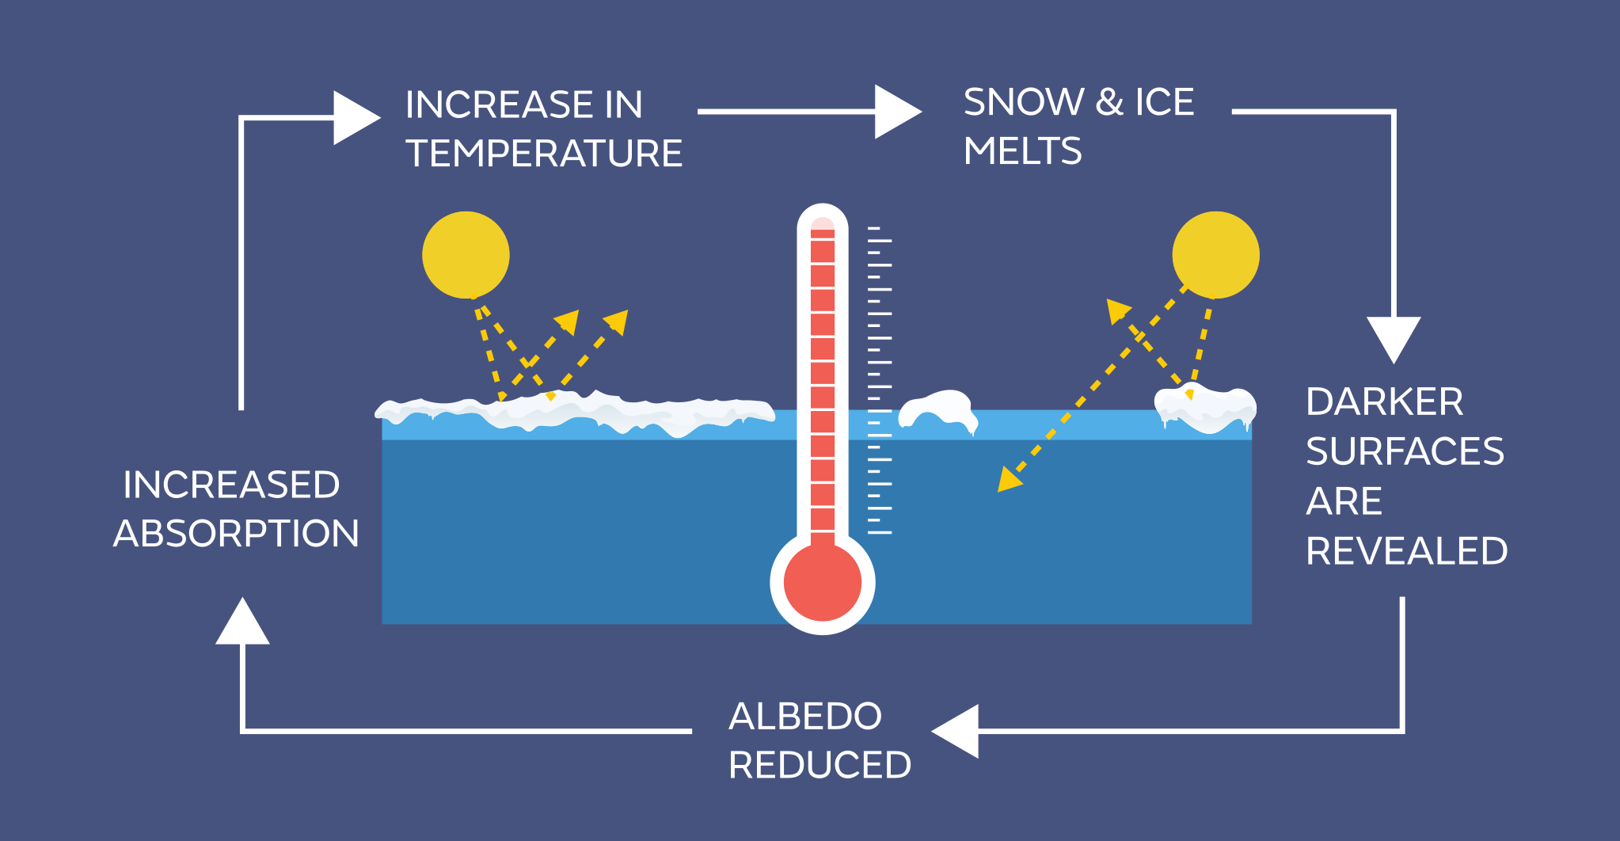
1. Positive feedback on climate change
From Met Office
Notes:
One mechanism that can enhance the decline in sea ice in a warming climate is called the 'ice-albedo feedback'. This feedback loop begins with melting of the sea ice due to increased atmospheric and oceanic temperatures. The melting of the ice reveals the ocean surface below. The ocean is much darker than the more reflective ice which means that the albedo (or reflectivity) of the Arctic surface is reduced, resulting in higher absorption of solar radiation. The increased solar heating causes more ice to melt which, in turn, exposes more of the darker ocean surface, and increases solar absorption still further. The ice-albedo feedback is strongest during the summer when solar radiation is at its highest.

Slide 15
2. Sea ices and ocean currents
The global conveyor belt of ocean currents, aka "thermohaline circulation."
Notes:
By regulating polar heat, sea ice also affects weather worldwide. That's because the oceans and air act as heat engines, moving heat to the poles in a constant quest for balance. One way is atmospheric circulation, or the large-scale movement of air. Another, slower method occurs underwater, where ocean currents move heat along a "global conveyor belt" in a process called thermohaline circulation. Fueled by local variations in warmth and salinity, this drives weather patterns at sea and on land.

Slide 16
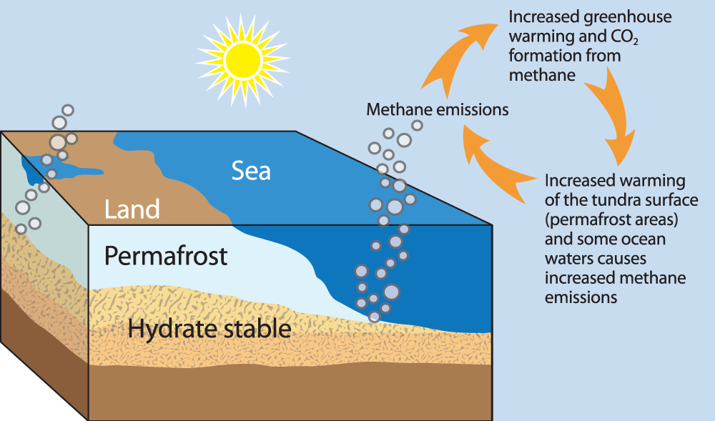
3. Sea Ices and methane at bay
Notes:
Scientists have long known Arctic tundra and marine sediments contain large, frozen deposits of methane, posing a climate risk if they thaw and release the potent greenhouse gas. But in 2012, researchers from NASA's Jet Propulsion Laboratory discovered "a surprising and potentially important" new source of Arctic methane: the Arctic Ocean itself. Flying north of the Chukchi and Beaufort seas, the researchers found mysterious methane fumes that couldn't be explained by typical sources like wetlands, geologic reservoirs or industrial facilities. Noticing the gas was absent over solid sea ice, they finally traced its source to surface waters exposed by broken ice. They still aren't sure why there's methane in Arctic seawater, but microbes and seabed sediments are likely suspects.

Slide 17
Gaps in sea ice can release methane into the atmosphere, scientists have discovered. (Photo: NOAA)

Slide 18
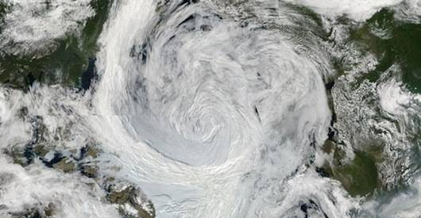
4. Sea ice and severe weather
Arctic storms erode and re-create landscapes. In Alaska, such storms can relocate coasts, islands, or any sediment that is not frozen into place. These storms are larger than hurricanes, sometimes spreading a quarter of the distance across the Bering Sea—more than 77,200 square miles (200,000 km²).
Satellites spotted this unusually strong storm in the Arctic Ocean on Aug. 5, 2012. (Photo: NASA)
Notes:
It's well-established that global warming boosts severe weather in general, but according to the NSIDC, sea-ice loss also favors bigger storms in the Arctic itself. Unbroken swaths of sea ice normally limit how much moisture moves from the ocean to the atmosphere, making it harder for strong storms to develop. As sea ice dwindles, storm formation is easier and ocean waves can grow larger. "[W]ith the recent decline in summer sea ice extent," the NSIDC reports, "these storms and waves are more common, and coastal erosion is threatening some communities."

Slide 19
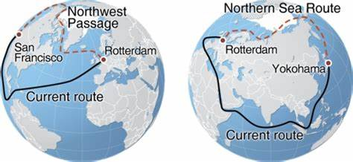
Other effects
the Arctic shipping routes
Notes:
Farther offshore, the retreating ice is often deemed good news for the oil, gas and shipping industries, which are already jockeying for drilling rights and shipping routes in newly ice-free waters. Such activity could pose risks on its own — from whales killed by ship strikes to shores fouled by oil spills — yet may also be hindered by stronger storms and waves, thanks to the same declining sea ice that enabled it in the first place.

Slide 20
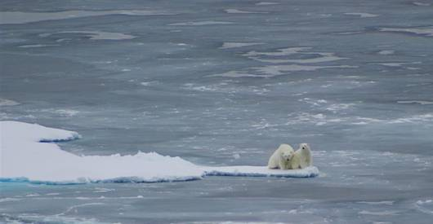
Other influences
Inuit and other indigenous Arctic people often travel across sea ice by snowmobile. (Photo: NOAA)
Polar bears and other animals are struggling to adapt to less sea ice. (Photo: Continentalshelf.gov)

Slide 21
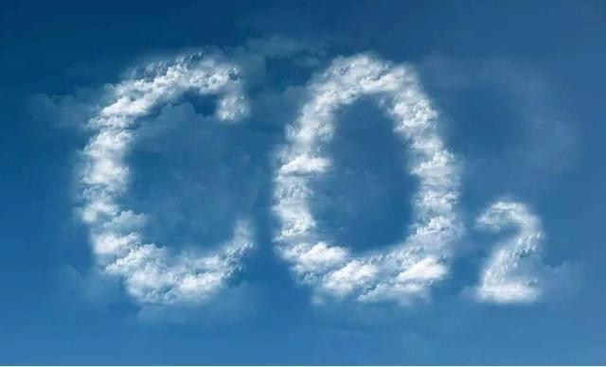

Slide 22
References
Reports from Zhao JinPing, Huang JianBin’ report(Tsinghua University), Dahe Qin and Russell McLendon.
IPCC, AR6, 2021
Weather and climate change - Met Office
Sea Ice (nasa.gov)
sea ice | Formation, Extent, & Facts | Britannica
Sea Ice | NESDIS (noaa.gov)

Slide 23
Thank You for Listening!

