Slide 1
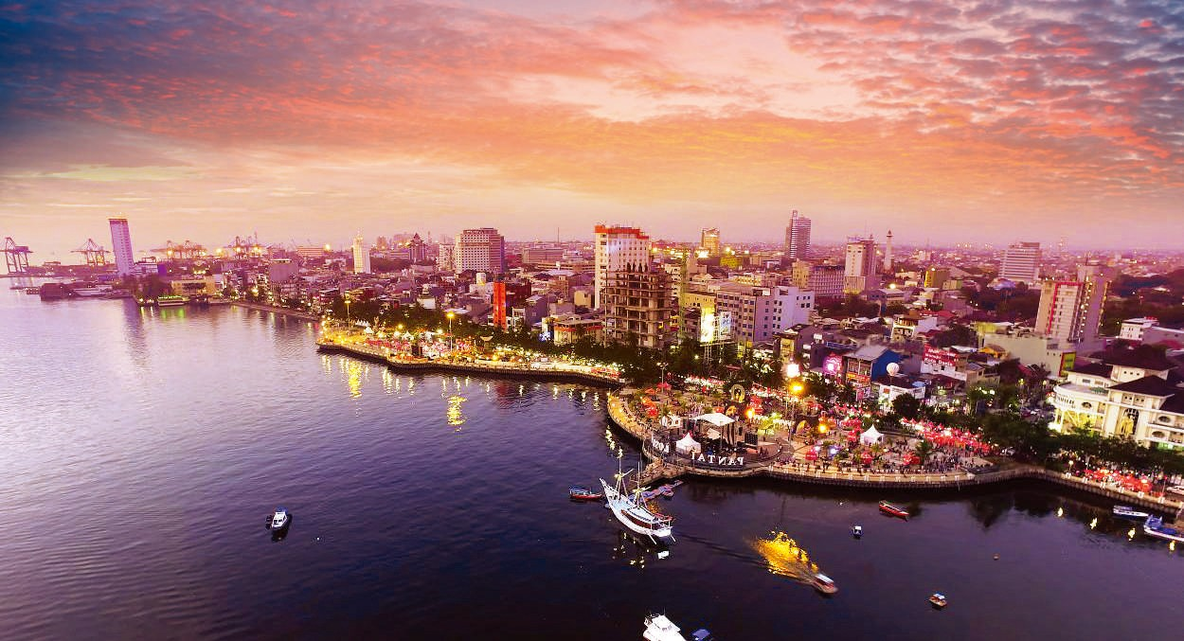
CITY OF
M A K A S S A R C I T Y
MAKASSAR
Mitigation of Climate Change Impatcs with Reclamation in Makassar
SOMBERE’ & SMART CITY
Ismawaty Nur, PhD

Slide 2
CITY of MAKASSAR
1
75 minutes from bali, 45 minutes from
nusantara ( new capital )
2
centerpoint of indonesia
3
the biggest city
in eastern indonesia
4
the highest economic growth in indonesia
5
home town of many indonesian leaders
MOH. RAMDHAN POMANTO, Mayor of Makassar
SOMBERE’ & SMART CITY

Slide 3
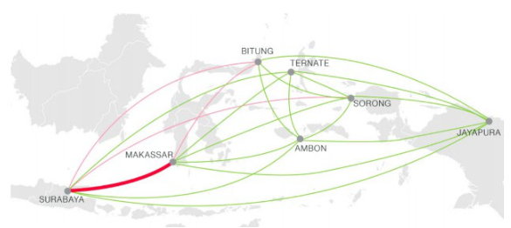
POSITIONING OF MAKASSAR IN INDONESIA

Slide 4
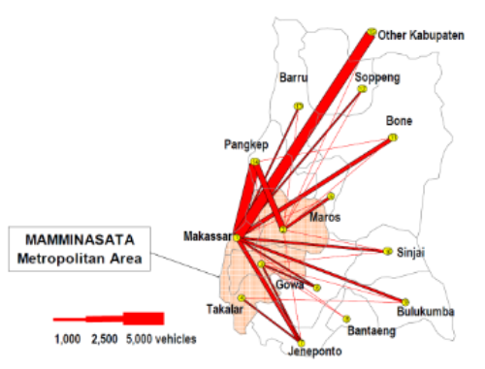
POSITIONING OF MAKASSAR IN SOUTH SULAWESI

Slide 5
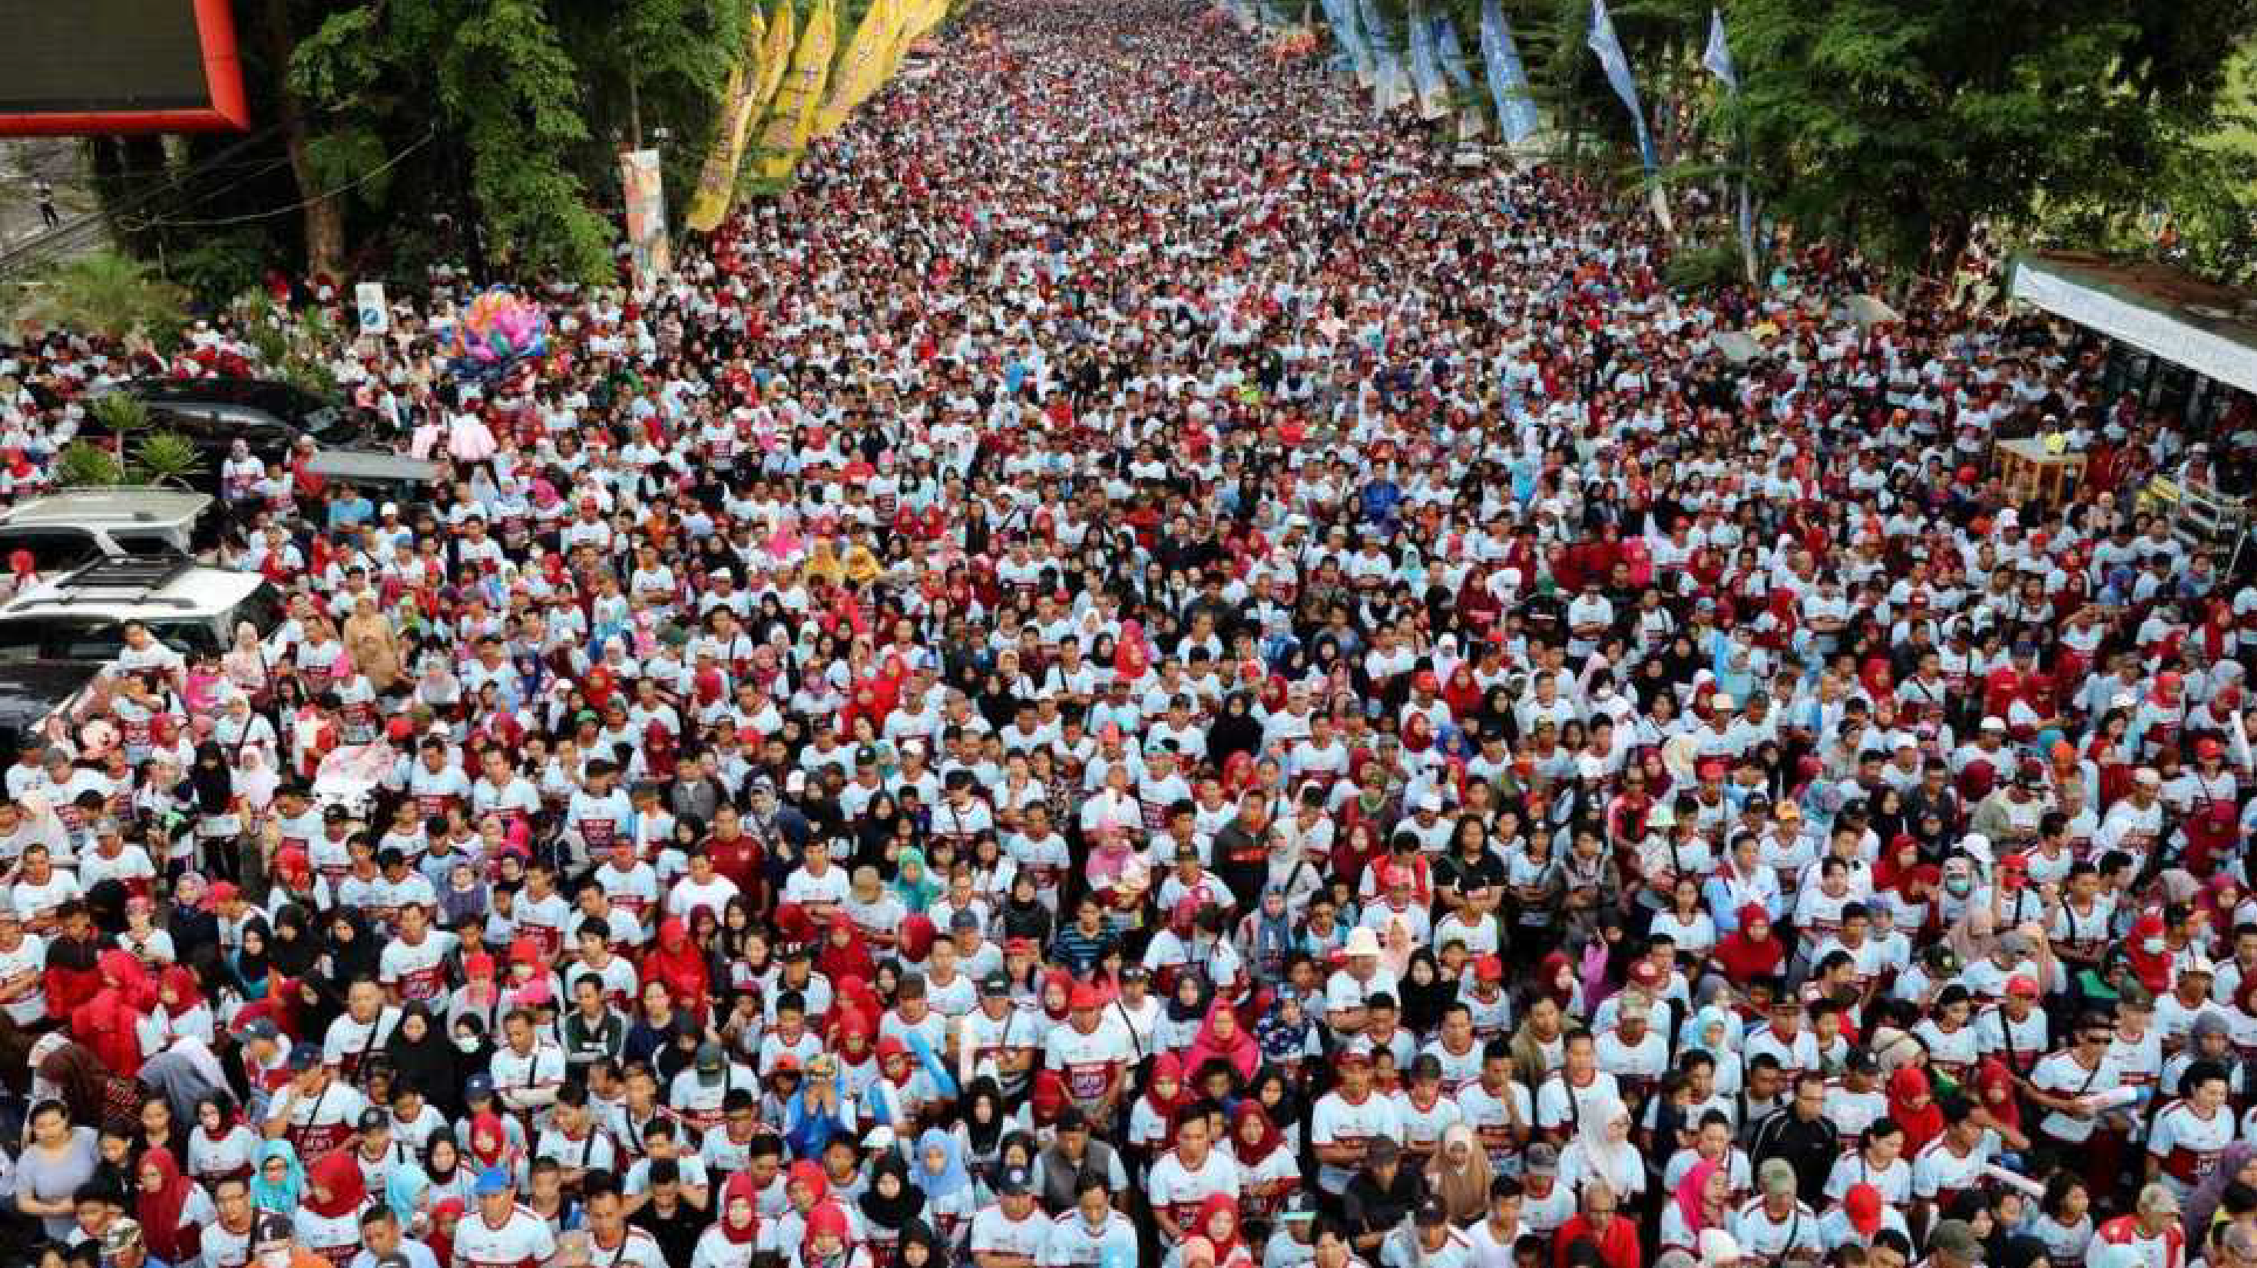
Makassar profiles
human development index
82,6 %
2021
population area
1.463.089 175,77
2022 KM2
gdp growth
4,47 %
2021
gdp income
RP.133,31T
2021
inflation rate
2,26 %
2021
poverty rate
4,82 %
2021
unemployment rate
13,67%
2021
satisfaction index
78,96%
2021
pdrb
747,204
2021
MOH. RAMDHAN POMANTO, Mayor of Makassar
SOMBERE’ & SMART CITY

Slide 6
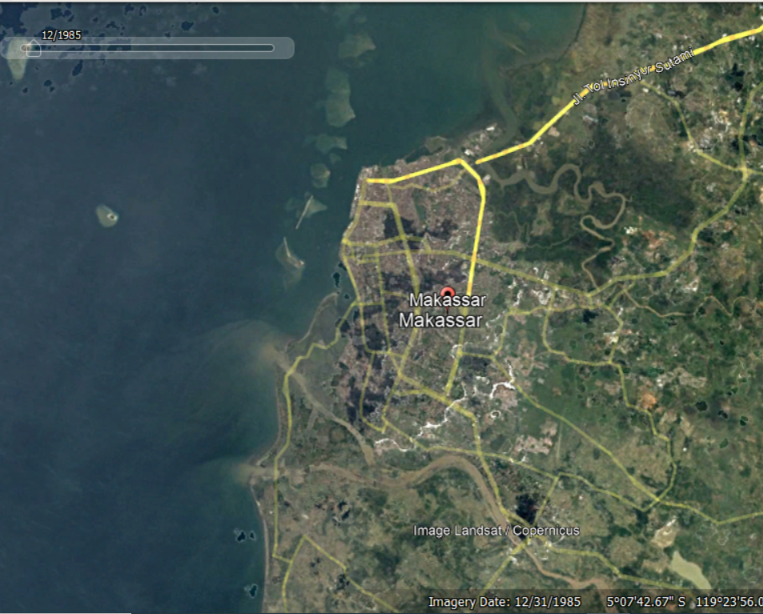
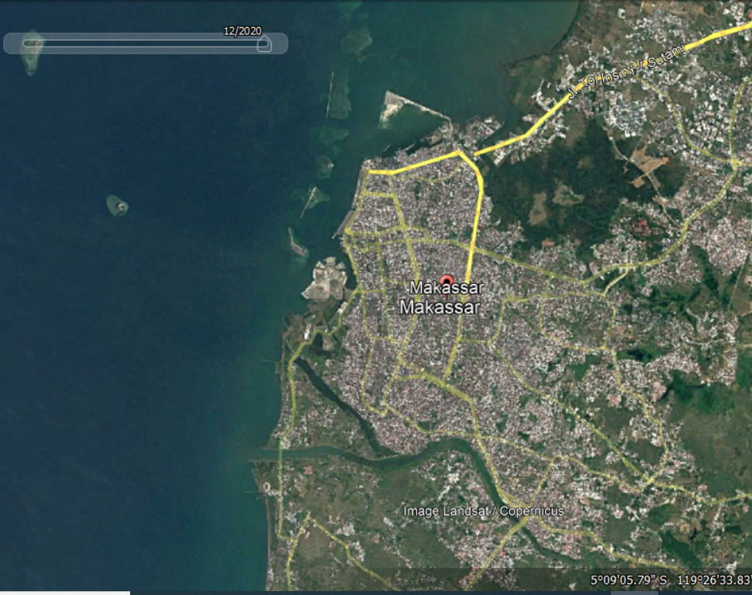
Makassar in 1985
Makassar in 2020

Slide 7
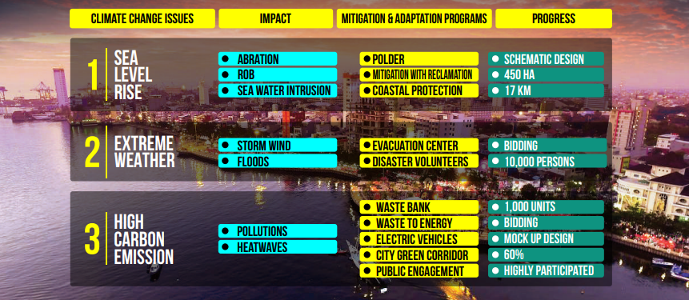
CLIMATE CHANGE IMPACTS IN MAKASSAR

Slide 8
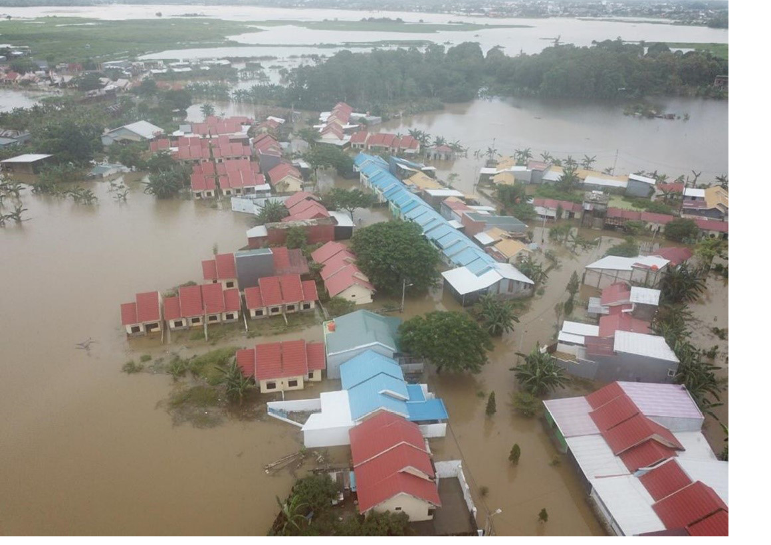
View of flooding in Makassar
Source: BPBD, March 2021

Slide 9
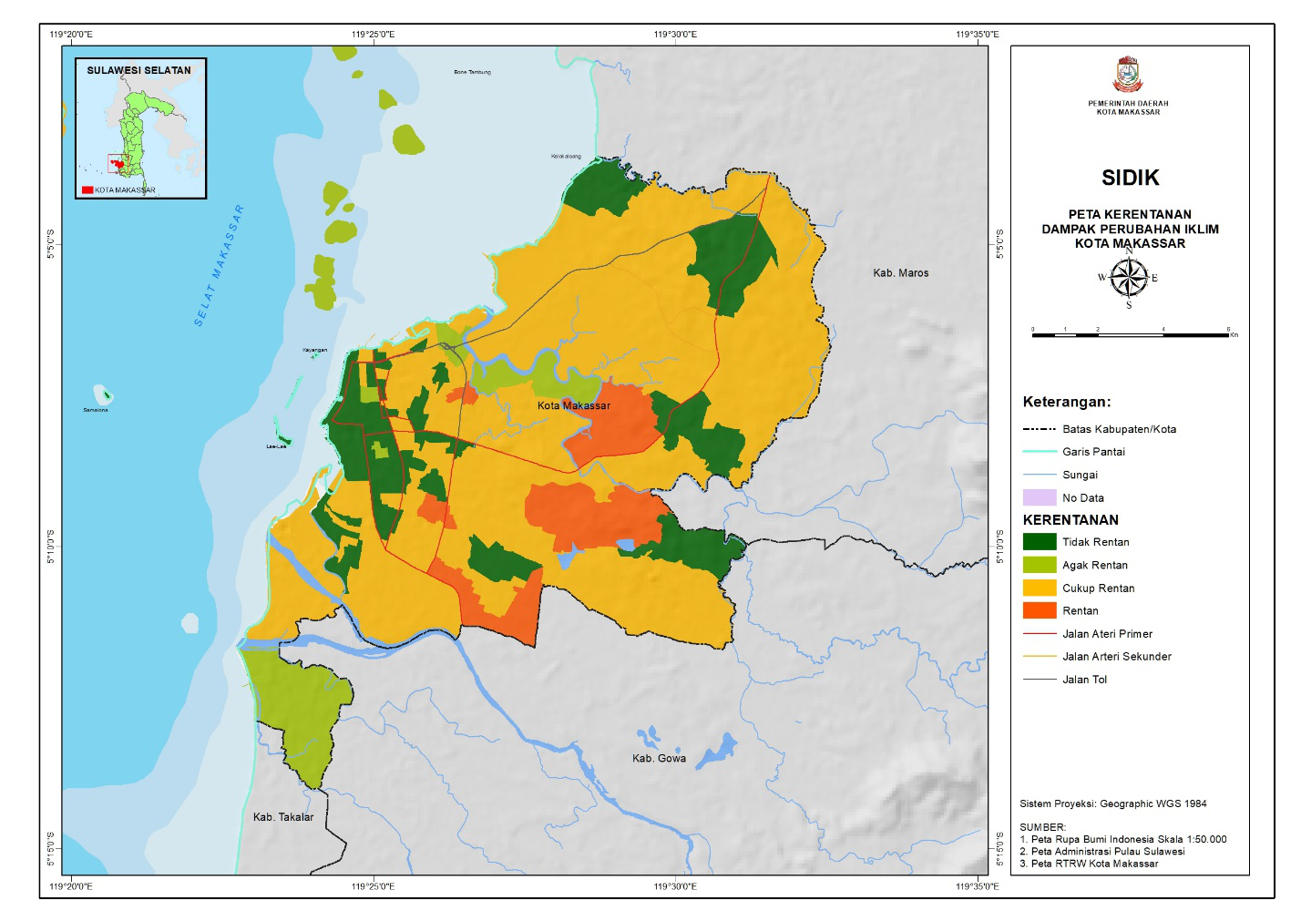
Vulnerability Map

Slide 10
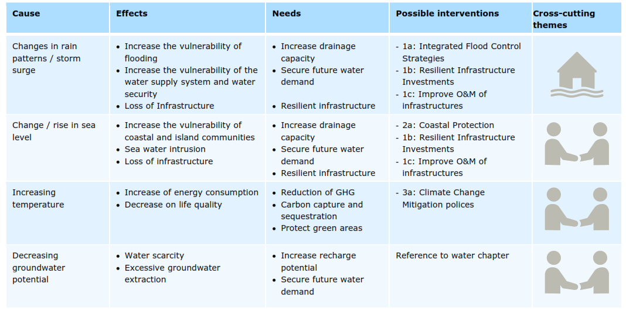
PLANNED INTERVENTIONS FOR CLIMATE RISK REDUCTION

Slide 11
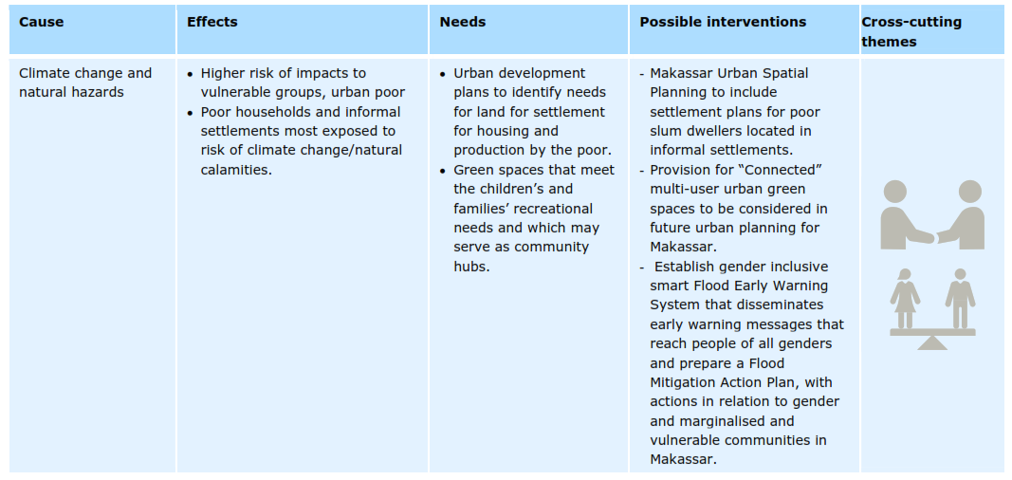
PLANNED INTERVENTIONS FOR CLIMATE RISK REDUCTION

Slide 12
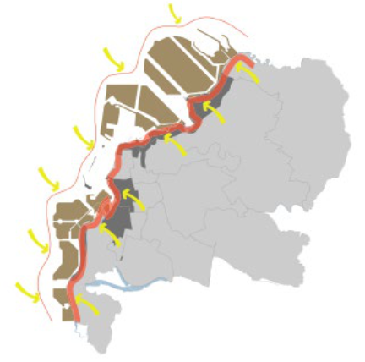
RECLAMATION PROJECTS FOR RISK MITIGATION

Slide 13
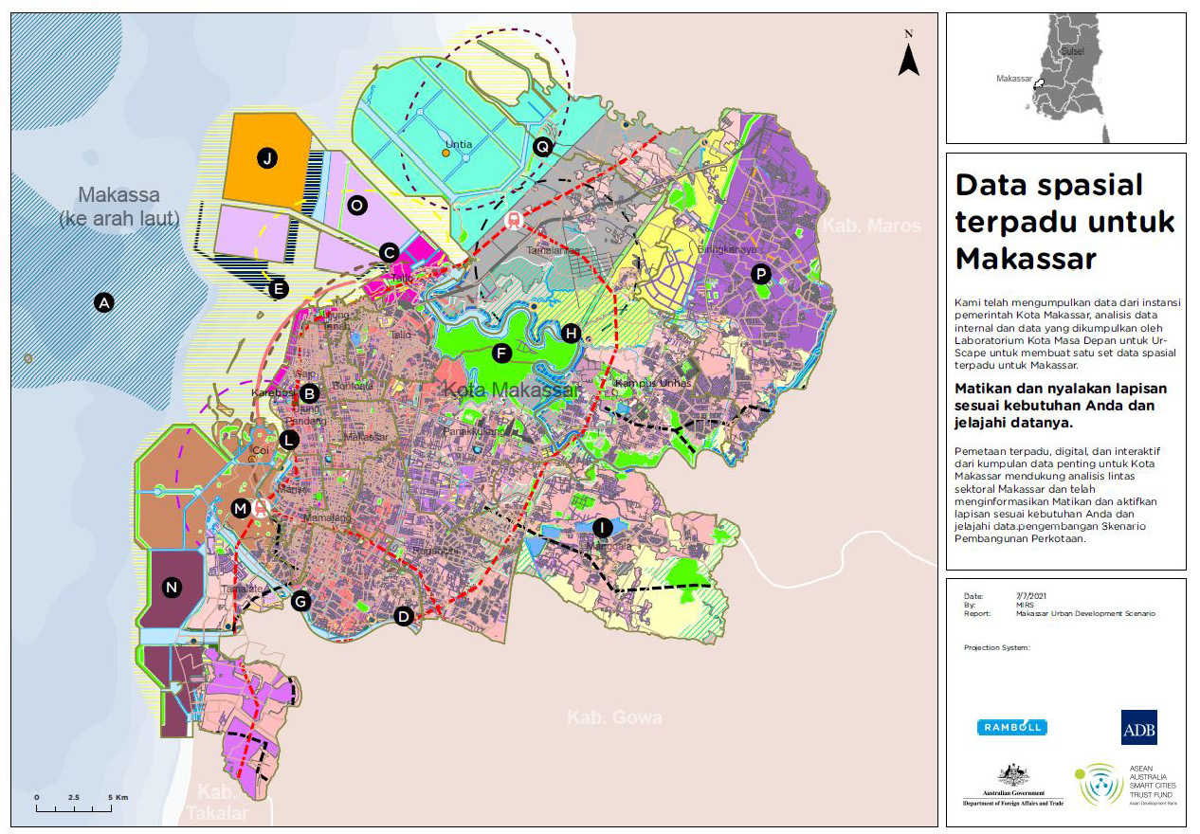

Slide 14
